Slide 1
Secure Data Hiding in Image Using Steganography
Student Name : Pooja Vasant Bhalekar
College Name & Department : P.E.S Modern College Of Engineering , Artificial Intelligence and Machine Learning

Slide 2
OUTLINE
Problem Statement
Technology used
Wow factor
End users
Result
Conclusion
Git-hub Link
Future scope

Slide 3
Problem Statement
In today's digital world, secure communication is a major concern. Traditional encryption methods are often detectable, making secret messages vulnerable to attacks. This project implements image steganography, where a hidden message is embedded inside an image using pixel manipulation.
The objective is to provide a covert and secure way of communication, ensuring confidentiality.

Slide 4
Technology used
Programming Language: Python
Libraries: OpenCV, NumPy
Platform: Google Colab (for execution)

Slide 5
Wow factors
Invisible Encryption: The message is hidden within an image without altering its appearance.
Password Protection: Only authorized users can decrypt the message.
Lightweight & Efficient: The system embeds and extracts data with minimal processing.
No External Tools Required: Works with basic Python libraries, eliminating dependencies.

Slide 6
End users
Cybersecurity Professionals (For secure data transmission)
Journalists & Activists (For confidential communication)
Government & Defense Agencies (For secure intelligence sharing)
General Users (For personal data protection)

Slide 7
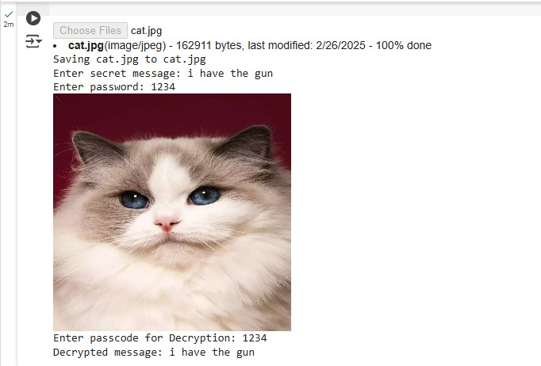
Results

Slide 8
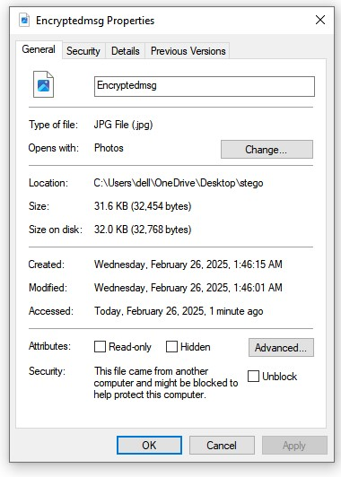
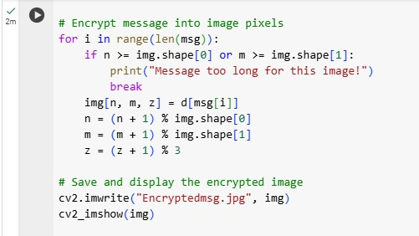
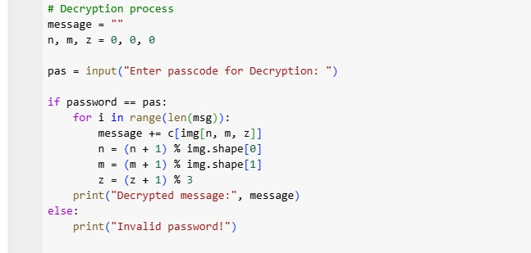

Slide 9
Conclusion
This project provides a covert, secure, and efficient way to transmit hidden messages. By leveraging image steganography, it ensures data confidentiality while keeping the existence of the message undetectable.

Slide 10
GitHub Link
https://github.com/skadesplaire01/Image-Steganography.git

Slide 11
Future scope(optional)
Advanced Encryption: Integrate AES or RSA encryption for enhanced security.
Higher Data Capacity: Improve encoding techniques to store more data.
Mobile & Web App Development: Create a user-friendly interface for broader accessibility.
AI-Powered Steganography: Use deep learning to make detection even harder.

Slide 12
THANK YOU

